Slide 1

Face Mask Deduction with Deep Learning
Gayathri Krishnamoorthy

Slide 2
Overview
Due to Covid worldwide, Face Mask has become mandatory for everyone. People around the world are wearing masks as a precautionary measure to prevent the spread of infection. In this project, a face mask detection model that can accurately detect whether a person is wearing a mask or not is proposed.

Slide 3
Image Dataset
The Image dataset was from Kaggle Dataset
Data set consists of 7553 images with 3(RGB) channels in 2 folders as with_mask and without_mask.
There were 3725 images of faces with_mask and 3828 images of faces without_mask.

Slide 4
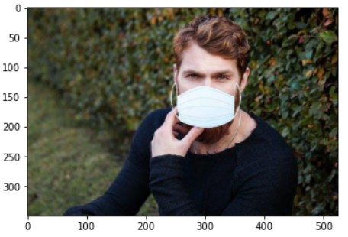
Exploratory Data Analysis
The image dimensions were 350 * 525, and the number of channels were 3. The below picture was randomly selected image from the data set.

Slide 5
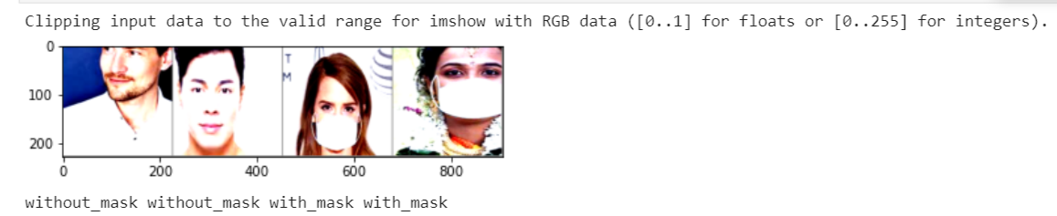
Data Preprocessing
Normalizing Image Inputs
Data normalization is an important step which ensures that each input parameter (pixel, in this case) has a similar data distribution. This makes convergence faster while training the network
Data normalization is done by subtracting the mean from each pixel and then dividing the result by the standard deviation
For image inputs we need the pixel numbers to be positive, so we might choose to scale the normalized data in the range [0,1]
Images needed to be scaled to size of 224 * 224 before modeling.
When splitting the data into training, validation and testing sets, the normalization statistics (mean and standard deviation) should come from the training Data
The shape of final tensor was (3,224,224)
The batch_size argument was set as 4 in Dataloader, as 4 images were passed at every iteration of training the network.

Slide 6
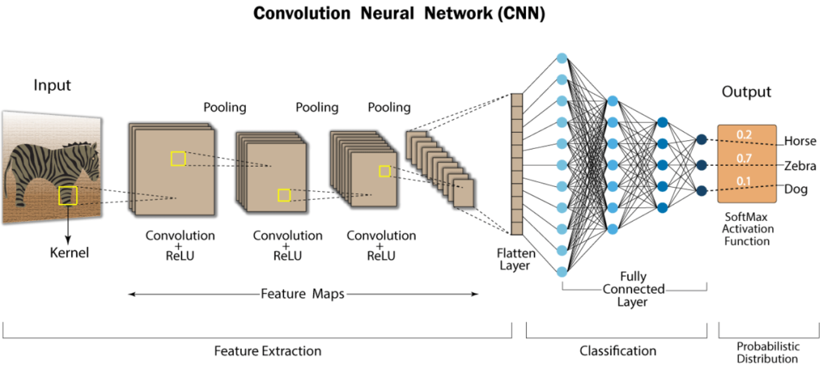
Modeling
CNN Model –
A Convolutional Neural Network (CNN) is a Deep Learning algorithm which can take in an input image, assign importance (learnable weights and biases) to various objects in the image and be able to differentiate one from the other.

Slide 7
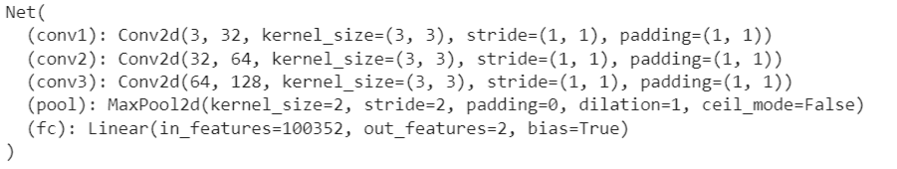
‘Net’ class for the CNN model
The proposed CNN model
Three Convolution Layer
Maxpooling for dimensionality reduction
Fully connect layer with ReLu function

Slide 8
Loss function
Loss ( error between predictions and actual values)
We want to reduce loss at each step
This means predictions are getting better
Loss Function
Categorical Cross Entropy was the loss function used (function used for multiple category problems) to calculate the loss and derivative (to minimize the loss)
The activation used on the output layer of the network is SoftMax (used to get probabilities for each class)

Slide 9
Optimizer
Optimizers are algorithms or methods used to change the attributes of neural network such as weights and learning rate in order to reduce the losses [minimize loss and maximize learning]
Stochastic Gradient Descent (SGD) was used in implementing gradient descent
It was not necessary to modify the default settings on the lr (learning rate=0.001)

Slide 10
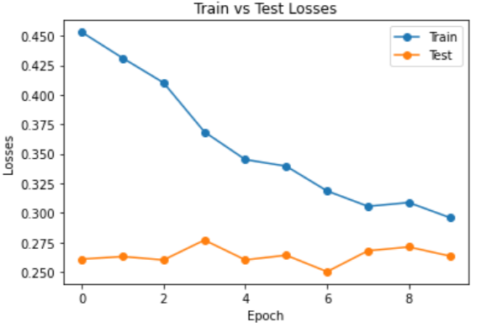
Training and Testing
From the above chart, the testing set was performing better than the training set
Training loss was reduced at each epoch and the testing loss is lower than the training, it indicates the testing set might be easier to predict than training
The training and testing accuracy of the model was around 89%

Slide 11
Transfer Learning
Transfer learning is a technique by which we can use the model weights trained on standard datasets such as ImageNet to improve the efficiency
To perform transfer learning import a pre-trained model using PyTorch, then freeze the weights for all the network except that of the final fully connected layer. This last fully connected layer is replaced with a new one with random weights and only this layer is trained
The Pretraining model used in this project –
ResNet 18
VGG16

Slide 12
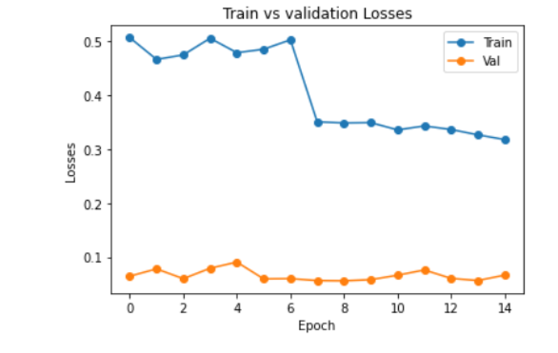
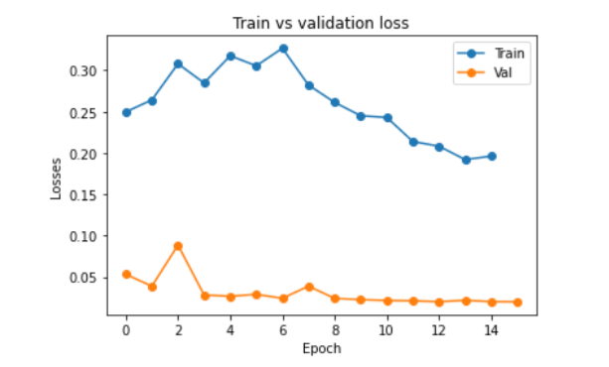
Modeling Results
VGG 16
ResNet 18
Train loss for both the models dropped at 7 epoch and loss has become a straight line
In both the models test loss started below 0.1 and stayed mostly constant
Testing loss seems to be lower than the training loss. In this case, it indicates that the validation dataset may be easier for the model to predict than the training dataset.

Slide 13
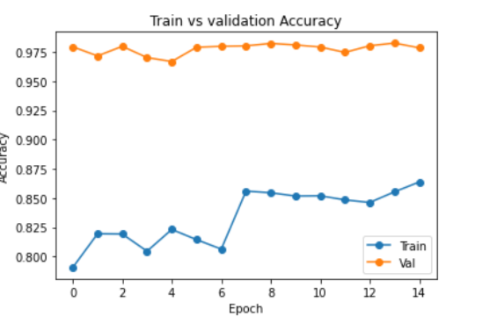
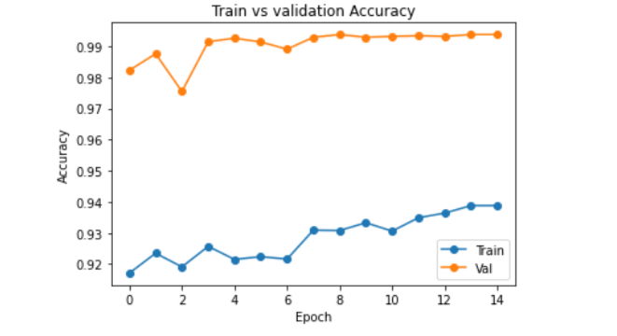
ResNet18
VGG 16
Accuracy of ResNet 18 was 98%
Accuracy of VGG 16 was 99%.
The accuracy was pretty good for both the models
The above accuracy chart indicates that the validation dataset may be easier for the model to predict than the training dataset.

Slide 14
Conclusion
The VGG16 Deep learning Model could be useful in classifying the images with mask and with out mask
The transfer learning allows to the model to perform well even with limited dataset
This model could be used in classifying the images in real time

